Slide 1
Automating Fabric Solution Deployment Guidance and Best Practices with CI/CD for Deploying and Updating Fabric Solutions

Slide 2
Agenda
Fabric Strategies for CI/CD and Automating Solution Deployment
Creating Workspace Items using the Fabric REST APIs
Challenges in Fabric CI/CD and Solution Deployment
Configuring Datasource Paths using Deployment Parameters
Deploying and Updating Solutions from a Source Workspace
Exporting and Deploying Solutions using Solution Folders
Connecting Workspaces using Fabric GIT Integration
Setting Up Staged Deployments

Slide 3










Workspaces with Sample Fabric Solution Scenarios
Fabric Power BI Solution
Fabric Lakehouse Solution with Notebook
Fabric Lakehouse Solution with Shortcut and Notebooks
Fabric Lakehouse Solution with Data Pipeline and Notebooks
Semantic Model
Report
Lakehouse
Notebook
Semantic Model
Report
Lakehouse
Shortcut
Notebook
Notebook
Semantic Model
Report
Report
Report
Lakehouse
Notebook
Notebook
Data Pipeline
Semantic Model
Report
Report
Report

Slide 4
Workspace Item Types
Fabric solutions designed and implemented in terms of workspace items
Developers can discover, create and manage workspace items inside scope of a workspace
Workspace items are created and updated using item definitions
Creatable Workspace Item Types by Workload
Data Engineering
Power BI
Data Factory
Data Warehouse
Real-time Intelligence
Data Science
Lakehouse
SemanticModel
DataPipeline
Warehouse
Eventhouse
MLExperiment
Notebook
Report
Dataflow
MirroredWarehouse
Eventstream
MLModel
SparkJobDefinition
KQLDatabase
Environment
KQLQueryset
KQLDashbord

Slide 5
Programming with Fabric Item Definitions
Fabric items can be created and updated using item definitions
You can pass item definition when calling Create Item API
You can modify existing workspace item by calling Update Item Definition passing item definition
You can retrieve item definition for existing workspace item by calling Get Item Definition
Your Application
Fabric REST APIs
Item
Definition
POST - Create Item
Item
Definition
POST - Update Item Definition
Item
Definition
POST - Get Item Definition

Slide 6
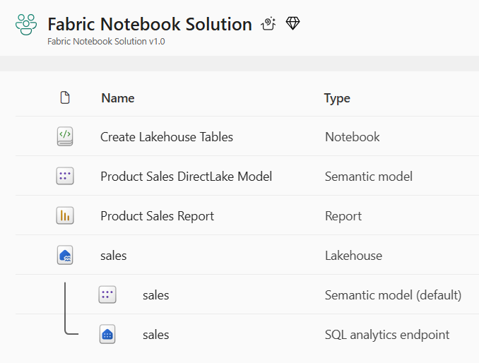
Developing a Custom API-driven Pipeline
Deploy workflow creates new target workspace and clones source workspace items
Deploy workflow always creates target workspace and builds it from scratch
Fabric REST APIs provide necessary CRUD APIs for managing workspace items
Update workflow processes set of updates on target workspace that already exists
Source workspace items that already exist in target workspace are updated
Source workspace items that do not already exist in target workspace are created
Source Workspace
Target Workspace
Deploy
Items
Source Workspace
Target Workspace
Update
Items

Slide 7
First Motivation for Custom API-driven Pipelines
Staged deployment used to push changes between environments like DEV>TEST >PROD
DEPLOY workflow creates downstream workspaces on demand
UPDATE workflow pushes out full update to all workspace items or partial update
DEPLOY and UPDATE workflows can cross environments such as Entra Id tenant boundaries
Building each stage requires configuring different datasource paths
DEPLOY workflow for must configure datasources differently for DEV, TEST and PROD
Entra Id tenant A
Entra Id tenant B
Entra Id tenant C
Dev Workspace
Test Workspace
Deploy
Items
Prod Workspace
Deploy
Items
Deploy
or
Update
Deploy
or
Update

Slide 8

Second Motivation for Custom API-driven Pipelines
Fabric provides development platform for building multi-tenant applications
Each customer tenant created using one or more Fabric workspaces
Developer uses Fabric REST APIs to create and configure workspaces and workspace items
Fabric Multi-tenant Environment
Entra Id Tenant Owned by ISV
Customer 1 Tenant Workspace
Customer 01
17 users
Lakehouse
Notebook
Semantic Model
Report
Custom
Multitenant Application
Customer 2 Tenant Workspace
Lakehouse
Notebook
Semantic Model
Report
Customer 02
85 users
Customer N Tenant Workspace
Lakehouse
Notebook
Semantic Model
Report
Customer N
450 users

Slide 9
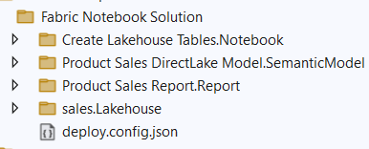
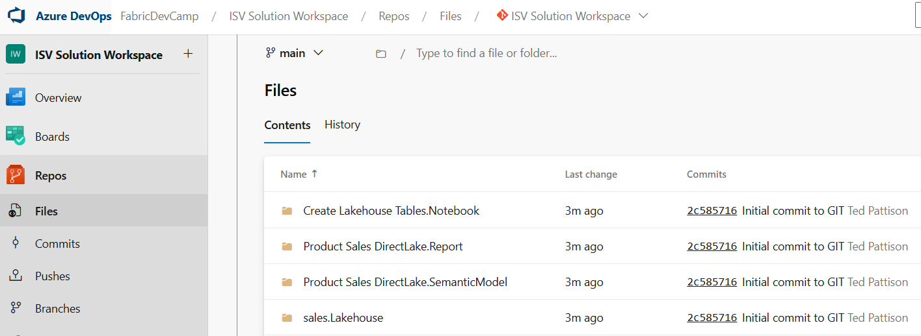
Options for API-driven Solution Deployment
Option 1: Deploy from source workspace
Option 2: Export workspace to local solution folder and then deploy from local solution folder
Option 3: Export workspace to ADO repo branch and then deploy from that repo branch
Source Workspace
Solution Deployment Logic
Target
Workspace
Source Workspace
Packaged Solution Folder
Solution
Export
Logic
Solution Deployment Logic
Target
Workspace
Source Workspace
Solution
Export
Logic
Solution Deployment Logic
Target
Workspace

Slide 10
Agenda
Fabric Strategies for CI/CD and Automating Solution Deployment
Creating Workspace Items using the Fabric REST APIs
Challenges in Fabric CI/CD and Solution Deployment
Configuring Datasource Paths using Deployment Parameters
Deploying and Updating Solutions from a Source Workspace
Exporting and Deploying Solutions using Solution Folders
Connecting Workspaces using Fabric GIT Integration
Setting Up Staged Deployments

Slide 11
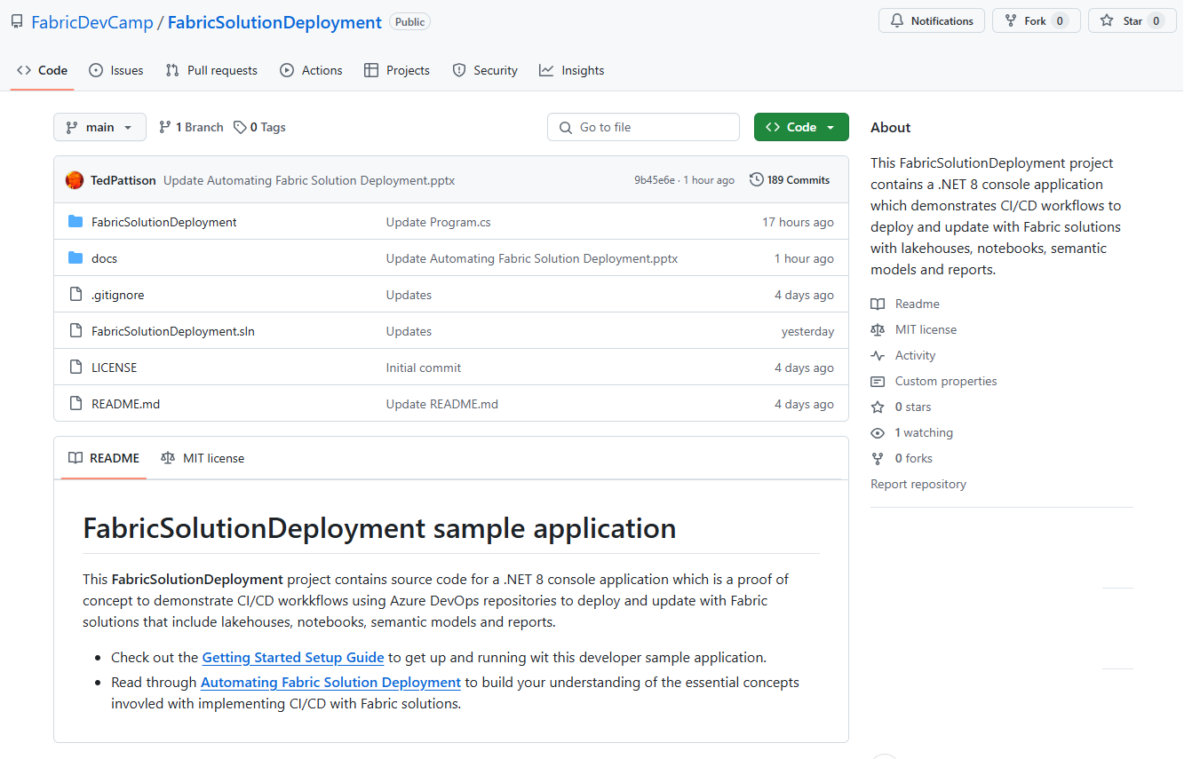
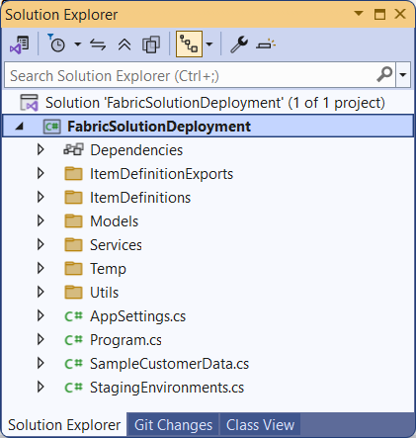
The FabricSolutionDeployment Developer Sample
Sample application demonstrating how to implement solution deployment workflows
Created as a .NET 8 console application using the Fabric REST API .NET SDK
Provides easy learning path for developers to download project and get up and running
https://github.com/FabricDevCamp/FabricSolutionDeployment

Slide 12
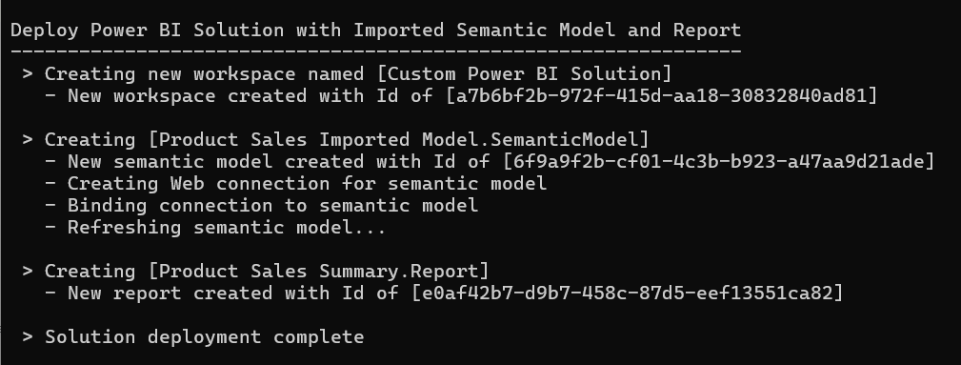
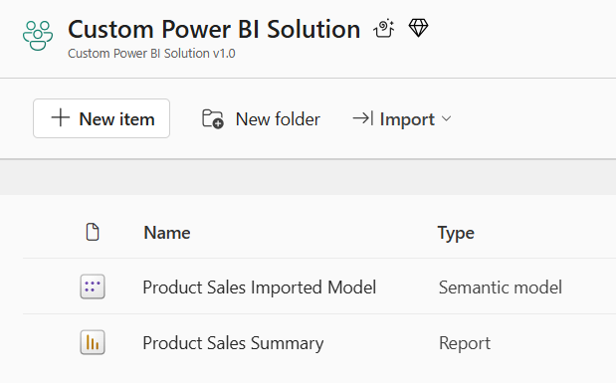
Deploy the Power BI Solution

Slide 13
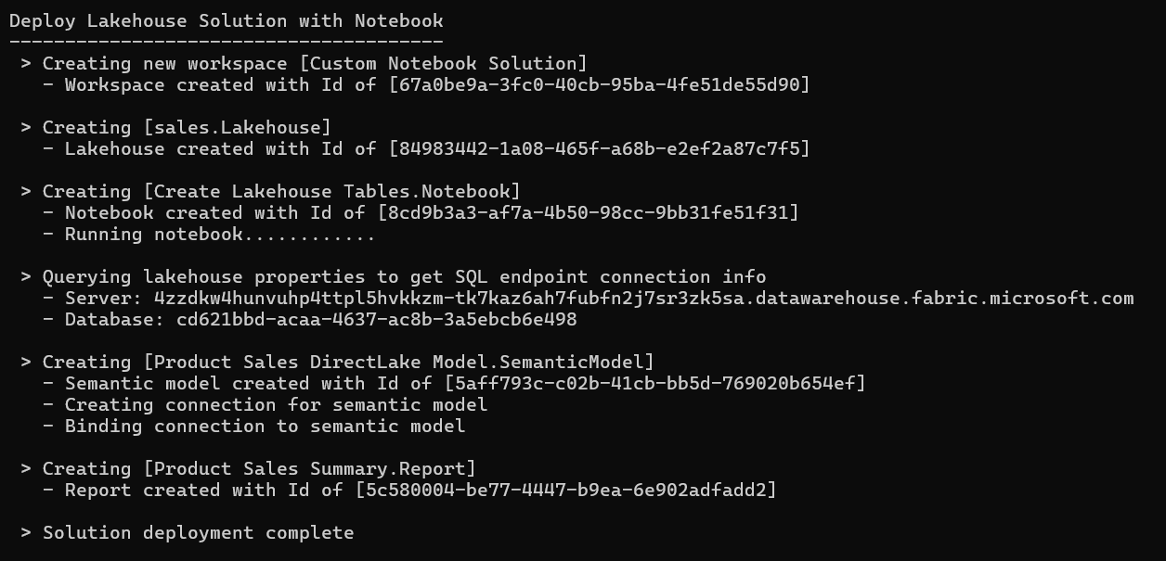
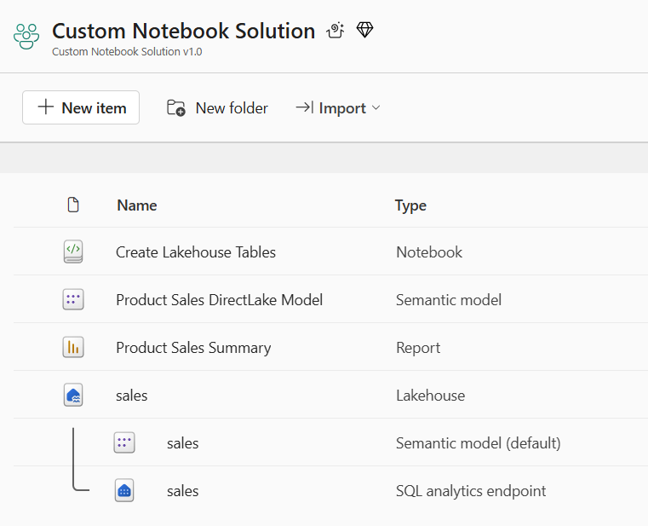
Deploy the Notebook Solution

Slide 14
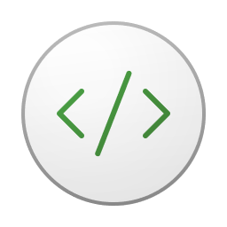

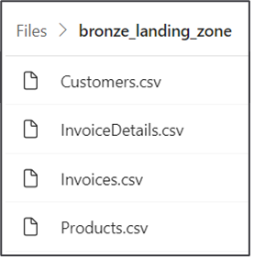
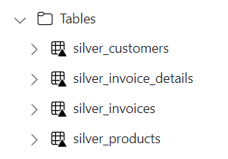
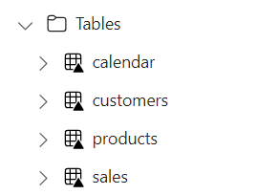


Using Spark Jobs to Create Lakehouse Tables
Fabric provides Spark runtime
Notebooks contain python code commonly used to ingest data files and build tables
Common practice to follow medallion architectures (bronze>silver>gold)
Fabric REST APIs provide Job Scheduler to run notebook and monitor its execution
Customer Tenant Workspace
Environment
Lakehouse
bronze layer
silver layer
gold layer
notebook
Spark job
Spark job
Spark job

Slide 15

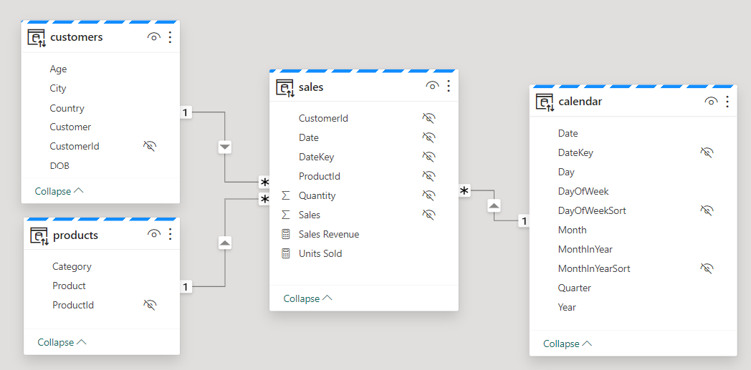
Creating Semantic Models on Lakehouse Tables
Creating semantic model on lakehouse tables uses DirectLake mode
Semantic model created by passing model.bim to Create Item API
Semantic model allow you to define relationships, measures, hierarchies, etc.
CAVEAT: DirectLake semantic models do not support many import-mode features
Customer Tenant Workspace
Lakehouse
Semantic Model (aka Dataset)
SQL Endpoint

Slide 16
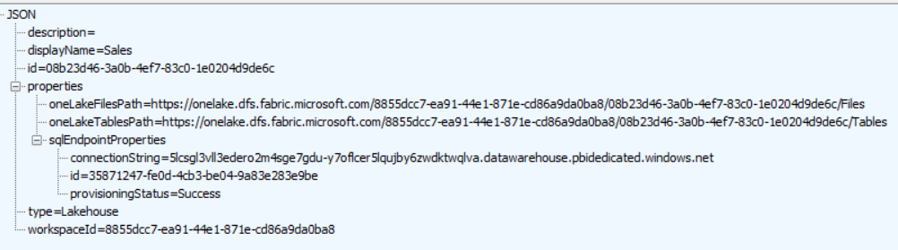
Lakehouse Properties
Retrieve lakehouse properties by executing GET request through /lakehouses endpoint
GET request with target URL of /workspaces/{WORKSPACE_ID}/lakehouses/{LAKEHOUSE_ID}
JSON response provides sqlEndpointProperties data required to create semantic model
SQL Connection Info

Slide 17
Sequence of Deployment Steps in Notebook Solution
Create lakehouse
Lakehouse has no dependencies on other workspace items
After creation, track lakehouse id for later use
Query lakehouse properties to discover SQL endpoint server connect string and database Id
Create notebook
Create notebook using updated item definition that includes workspace id & lakehouse id
Run notebook and monitor execution until completion to create lakehouse table schema
Create DirectLake semantic model
Create semantic model using updated item definition that includes SQL endpoint connect string
After creation, track semantic model id for later use
After creation, create & bind connection and then refresh semantic model (if required)
Create Power BI report
Create report using updated item definition that includes semantic model id

Slide 18
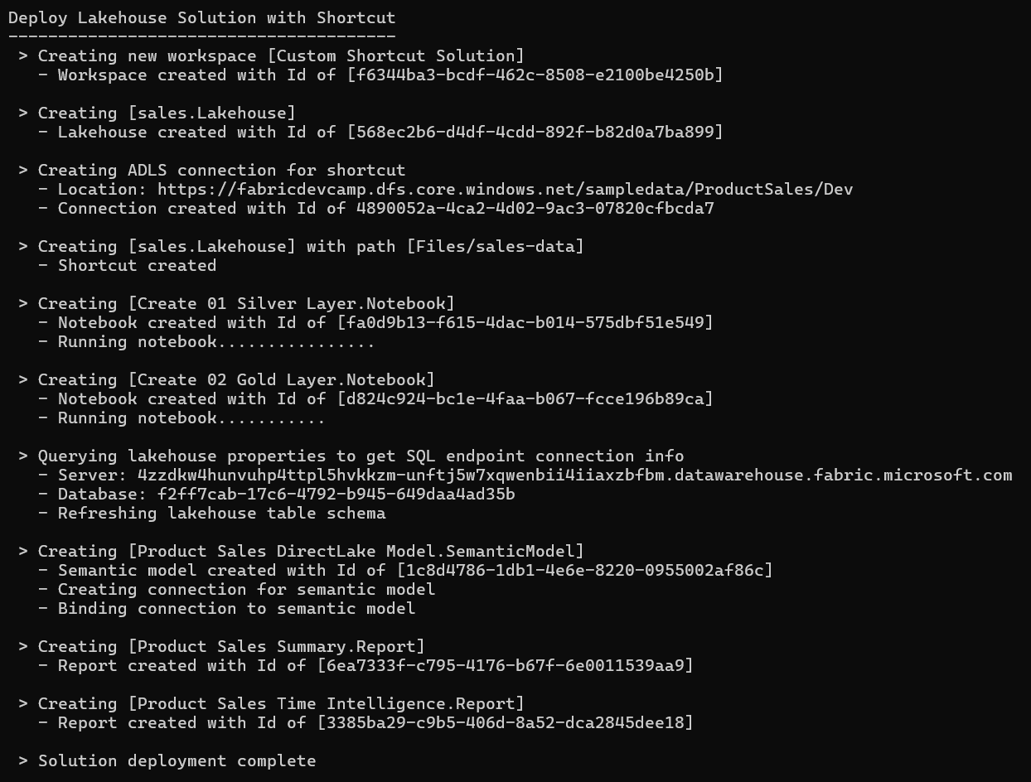
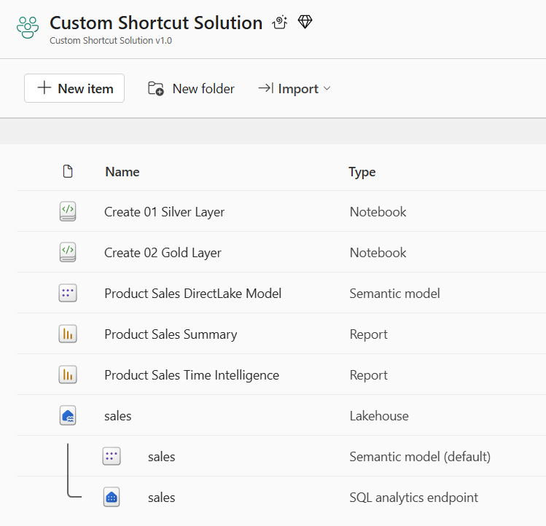
Deploy Shortcut Solution

Slide 19
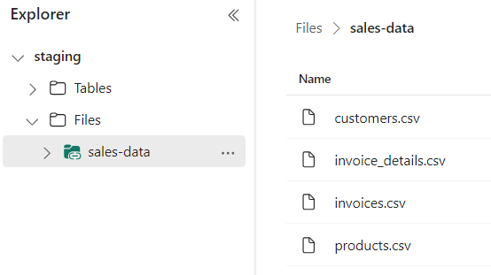
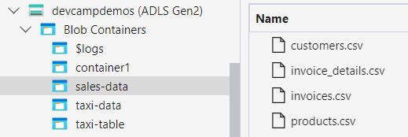
OneLake Shortcut Fundamentals
What is a OneLake shortcut?
A shortcut is an OneLake object that points to another internal or external storage location
Shortcuts can be created in lakehouses and Kusto Query Language (KQL) databases
OneLake supports shortcuts targeting external locations in ADLS, Amazon S3 and Dataverse
Shortcuts behave like symbolic links
Shortcuts are independent objects from the target source
If you delete a shortcut, the target remains unaffected
If you move, rename, or delete a target path, the shortcut can break
Shortcut has unique icons
Shortcut acts as pointer to storage location

Slide 20
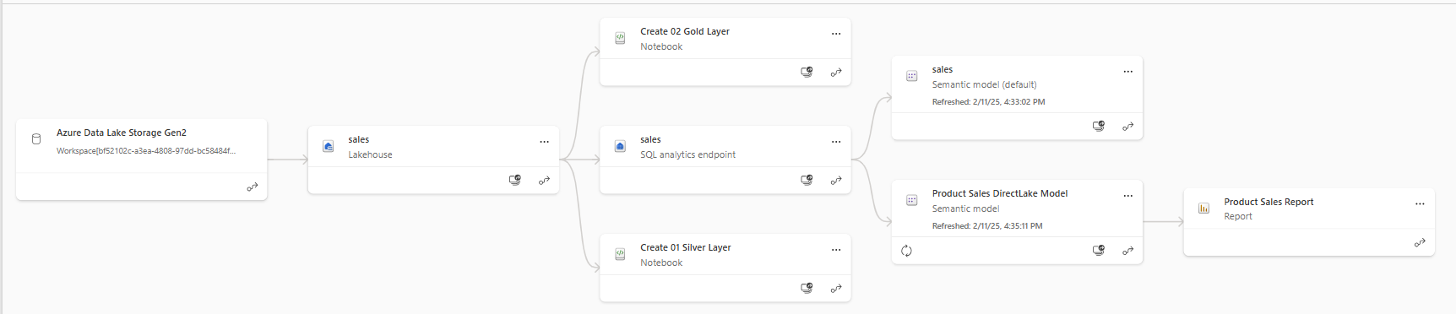
Shortcut Solution Post Deployment
All dependencies are self-contained within the new workspace
There are no dependances on workspace items in other workspaces

Slide 21
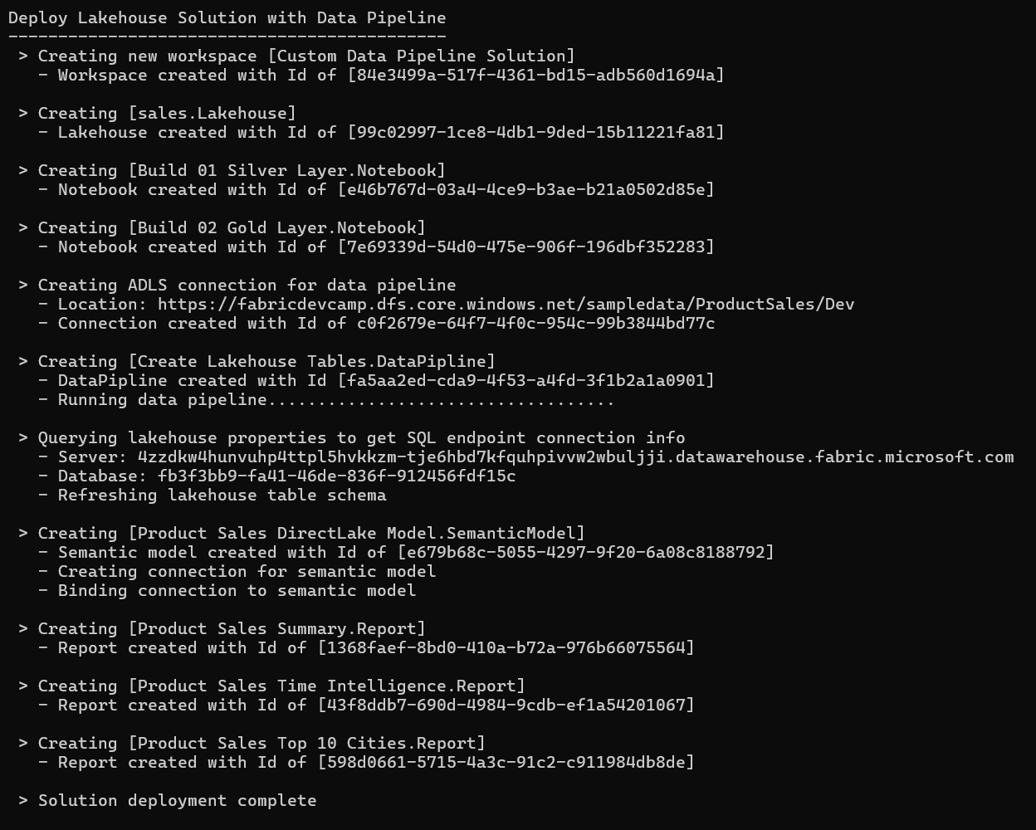
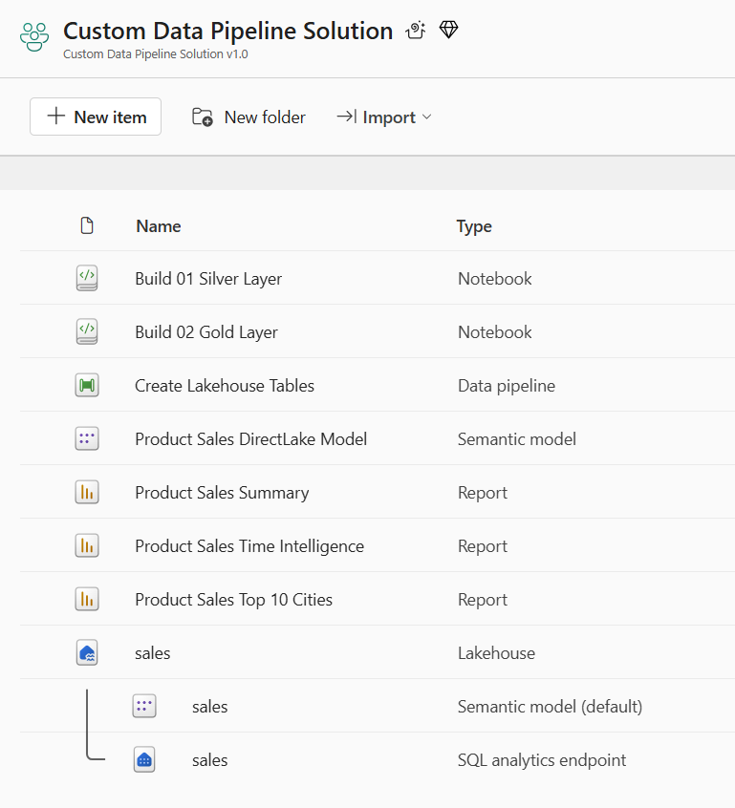
Deploy the Data Pipeline Solution

Slide 22
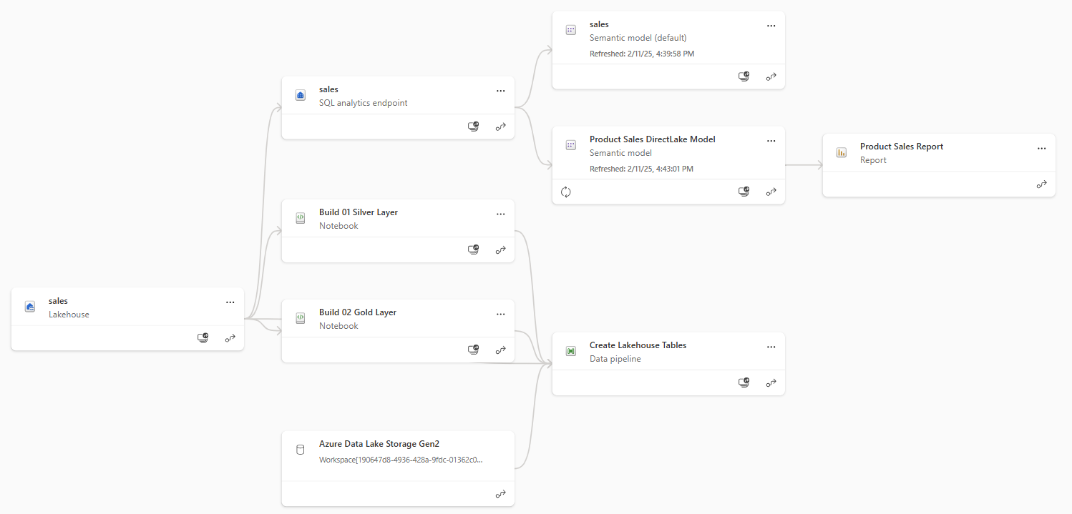
Data Pipeline Solution Post Deployment
All dependencies are self-contained within the new workspace
There are no dependances on workspace items in other workspaces

Slide 23
Agenda
Fabric Strategies for CI/CD and Automating Solution Deployment
Creating Workspace Items using the Fabric REST APIs
Challenges in Fabric CI/CD and Solution Deployment
Configuring Datasource Paths using Deployment Parameters
Deploying and Updating Solutions from a Source Workspace
Exporting and Deploying Solutions using Solution Folders
Connecting Workspaces using Fabric GIT Integration
Setting Up Staged Deployments

Slide 24
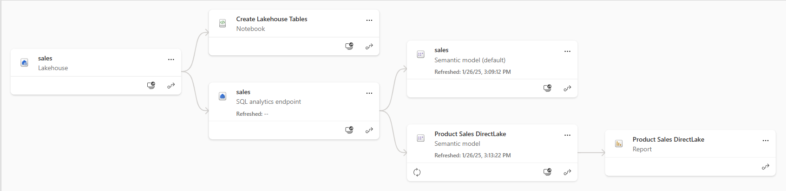
Understanding Workspace Item Dependencies
Many workspace items have dependencies on other workspace items
Lakehouse depends on running notebooks and/or data pipelines to create table schema
Notebook definition depends on workspace id and lakehouse id to reference its default lakehouse
DirectLake semantic model definition depends on connection string to SQL endpoint of lakehouse
Report definition depends on semantic model id
After deployment, solution should not have dependencies on other workspaces
All dependencies should be self-contained in new workspace
Fabric solution deployment requires custom logic to update dependencies accordingly

Slide 25
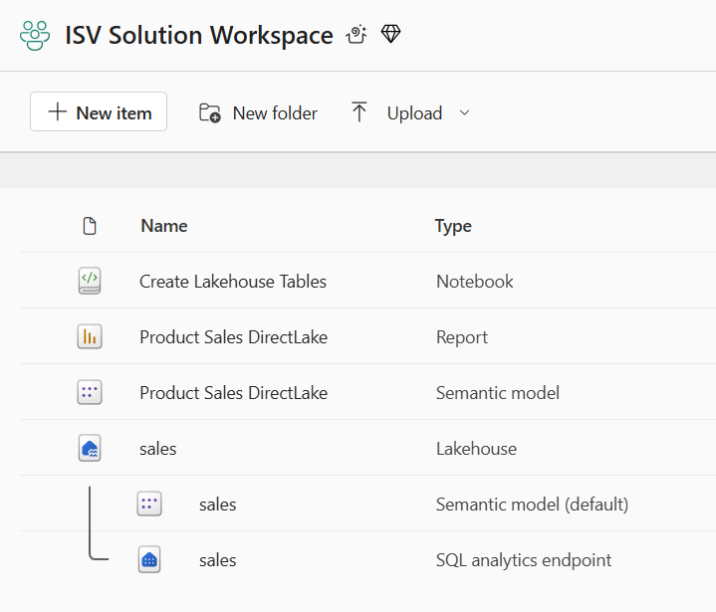
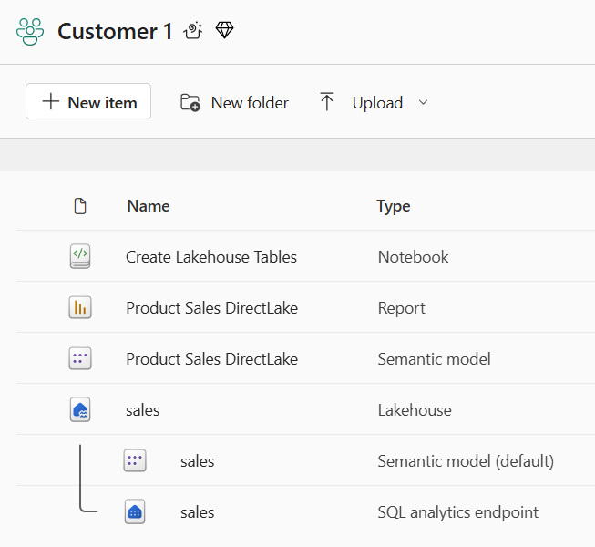
Creating Workspace Items with Dependencies
Deployment workflow must create workspace items with dependencies last
Notebook definition depends on lakehouse id for its default lakehouse
DirectLake semantic model definition depends on connection string to SQL endpoint of lakehouse
Report definition depends on semantic model id
Shallow copy of template workspace is not the result you want
Workspace for customer tenant should not have dependencies on source workspace
Source Workspace
Target Workspace

Slide 26
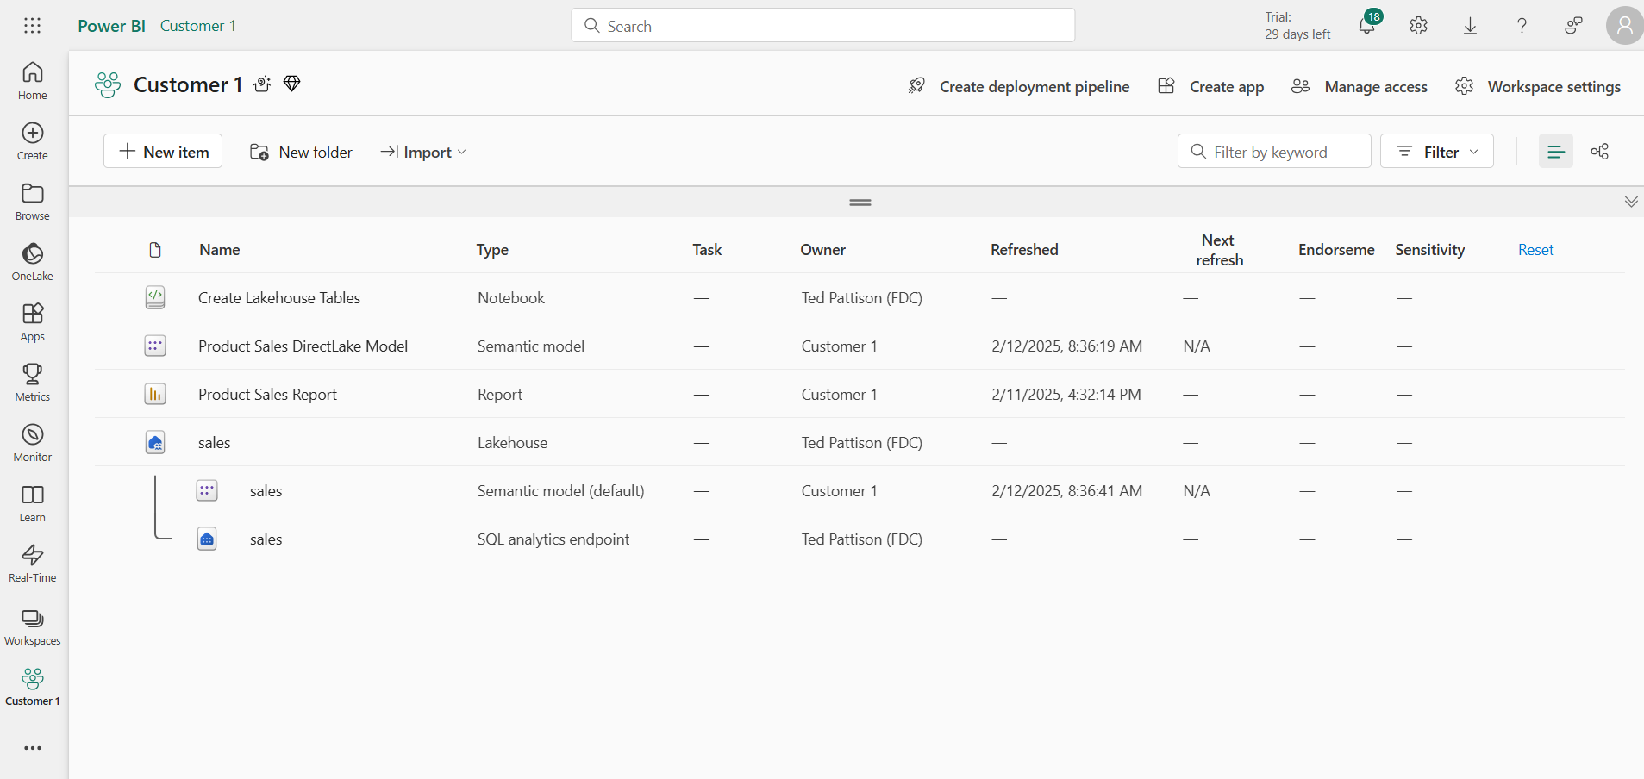
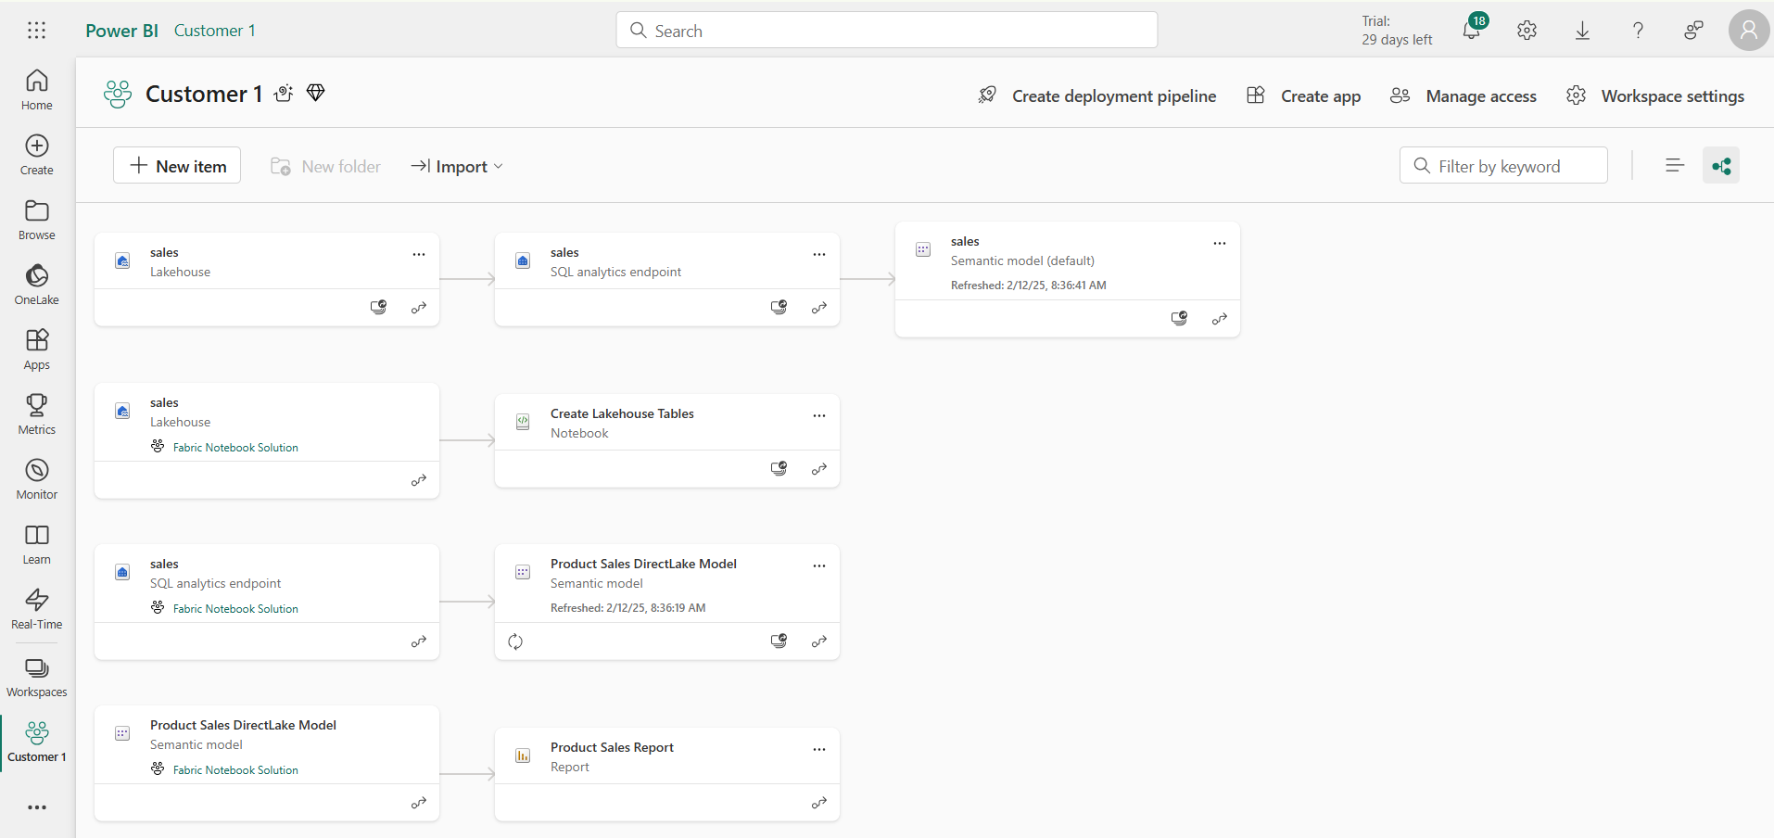
This deployment result IS NOT what you want
Checking for intra-workspace dependencies
Navigate to Lineage view to see item dependencies
Look for items that have dependencies on items in other workspaces

Slide 27
Deployment by Cloning Items from Source Workspace
Fabric items can be cloned using item definitions
Retrieve item definition from source workspace by calling Get Item Definition
Manipulate content of item definition part files such as substitute source Ids for target Ids
Pass manipulated item definition to Create Item API to create new item
Pass manipulated item definition to Update Item Definition API to update existing item
Source
Workspace
Your Application
Target
Workspace
Item
Definition
Item
Definition
Source
Definition
Create Item
Get Item Definition
update
Item
definition
Item
Definition
Updated
Definition
Update Item Definition

Slide 28
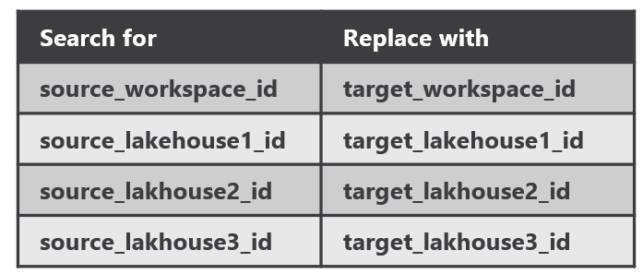
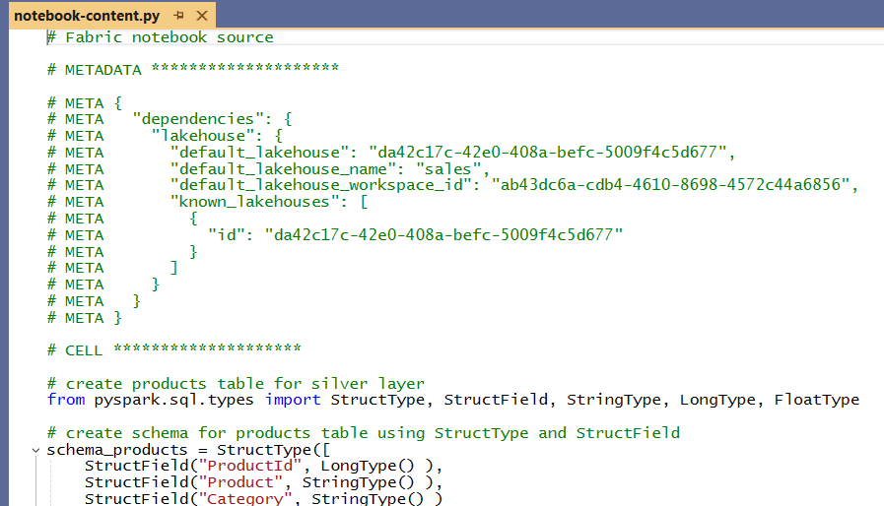
Performing Id Substitution with notebook-content.py
Notebook dependencies must be updated to point to newly created lakehouse
Source workspace Id must be replaced with target workspace id
Source lakehouse Id must be replaced with target workspace id
Substitution schema works even when there are multiple lakehouses
Your Application
Source
Definition
update
Item
definition
Search and Replace Operation
Output
Updated
Definition

Slide 29
Challenge of Managing Connections at Workspace Scope
Unlike workspace items, connection items are scoped at level of Entra Id tenant
No API support for workspace-level management of connections
No support in Fabric GIT integration to track, backup, restore, recreate connections
Developer must find innovative approach for managing connections at scope of workspace
Platform Item Types
Capacity
Workspace
Connection
Gateway
Workspace Item Types by Workload
Power BI
Data Engineering
Data Warehouse
Data Factory
Real-time Intelligence
Data Science
SemanticModel
Lakehouse
Warehouse
DataPipeline
Eventhouse
MLExperiment
Report
Notebook
MirroredWarehouse
Dataflow
Eventstream
MLModel
SparkJobDefinition
KQLDatabase
Environment
KQLQueryset
KQLDashbord

Slide 30
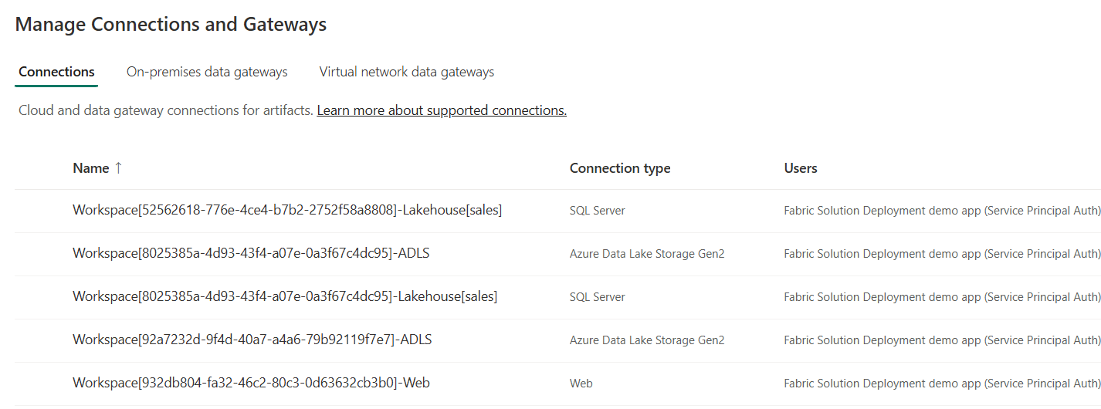
Using a Naing Convention for Managing Connections
Using connection naming convention allows for management at workspace scope
Connection name contains Workspace Id
Connection name also indicates connection type (e.g. Lakehouse(sales) vs ADLS vs Web)
Benefits to connection naming convention
It allows for cascading connection deletes when deleting workspace
Allows for discovery of connection when inspecting source workspace
Enables configuration when recreating lakehouse shortcuts and data pipelines
Workspace[WORKSPACE_ID]-Lakehouse[sales]
Workspace[WORKSPACE_ID]-ADLS
Workspace[WORKSPACE_ID]-Web

Slide 31
Parameterizing Datasources in Staged Deployment
Each stage in staged deployment should connect to its own needs datasource paths
DEV and TEST stage workspaces should not connect to same datasources as PROD
dev stage
test stage
production stage
Dev Workspace
Test Workspace
Prod Workspace
Deploy
or
Update
Deploy
or
Update
Dev DB
Test DB
Production DB

Slide 32
Parameterizing Customer Data and Datasource Paths
Solution design required to parameterize customer data
Deployment workflow must integrate creation parameters unique to each customer
This is especially true for datasource path
Customer 1 Datasources
Customer 1
Workspace
ADLS Gen2
Storage Container
Azure
SQL Database
Fabric Solution Template
Solution Deployment Logic
Customer 2 Datasources
Customer 2
Workspace
ADLS Gen2
Storage Container
Azure
SQL Database
Customer 3 Datasources
Customer 3
Workspace
ADLS Gen2
Storage Container
Azure
SQL Database

Slide 33
Agenda
Fabric Strategies for CI/CD and Automating Solution Deployment
Creating Workspace Items using the Fabric REST APIs
Challenges in Fabric CI/CD and Solution Deployment
Configuring Datasource Paths using Deployment Parameters
Deploying and Updating Solutions from a Source Workspace
Exporting and Deploying Solutions using Solution Folders
Connecting Workspaces using Fabric GIT Integration
Setting Up Staged Deployments

Slide 34
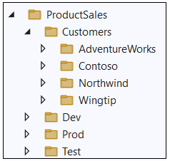
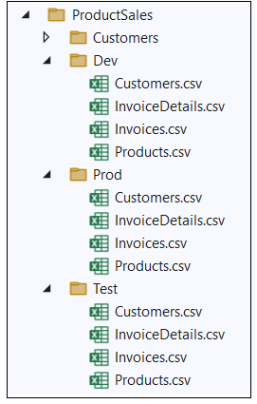
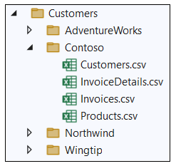
Sample Data Used in FabricSolutionDeployment
FabricSolutionDeployment uses Product Sales sample data
Sample data used to simulate data for different staging environments
Sample data used to simulate data for different customer tenants

Slide 35
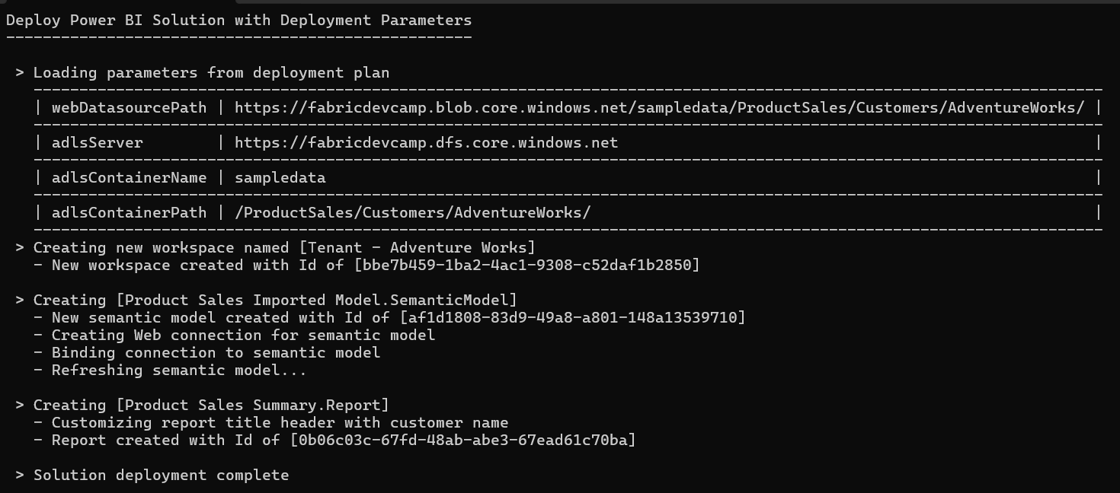
Deployment Parameters
FabricSolutionDeployment introduces concept of deployment parameters
Deployment logic in pipeline looks for presence of deployment parameters
When found, deployment parameters leads logic to modify target datasource paths

Slide 36
Where Do Datasource Paths Live in a Solution
Inside item definition files in semantic models
Example item definitions files with datasource paths include expressions.tmdl and model.bim
Inside Notebooks
Developers can add URLs directly in their python code
In connections
A connection is a credential bound to a datasource path
In shortcut
Shortcut created with datasource path
Shortcut must be bound to connection with same datasource path
In data pipeline
Data pipeline created to reference connection to external datasource
Connection created with target datasource path

Slide 37
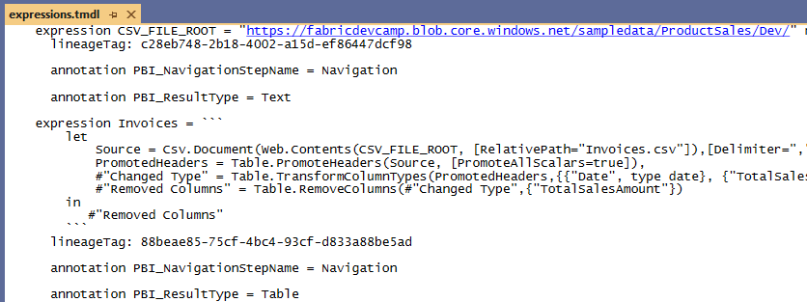
Data Path in an Imported Semantic Model

Slide 38
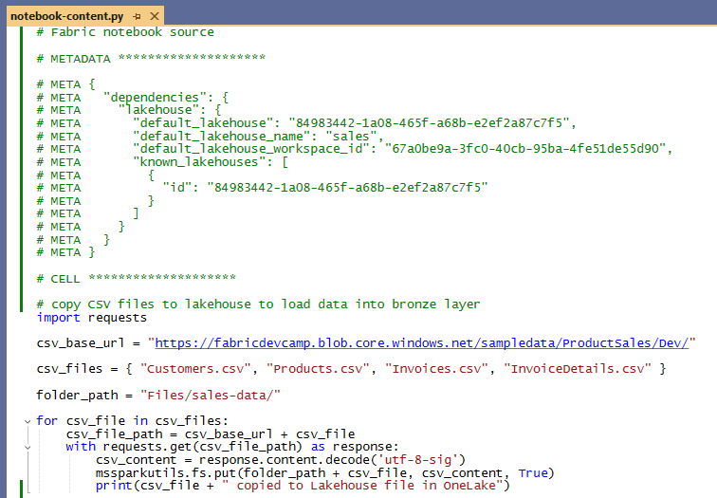
Datasource Path in a Notebook

Slide 39
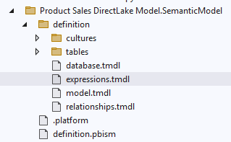
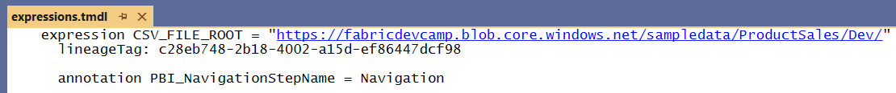
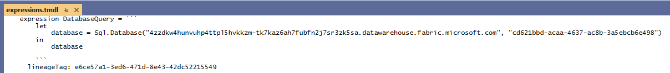
Data Source Path in a Semantic Model
The expressions.tmdl file is typical place to find datasource URL for semantic model
Example of imported model with datasource path for Web connection
Example of DirectLake model with datasource referencing lakehouse SQL endpoint

Slide 40
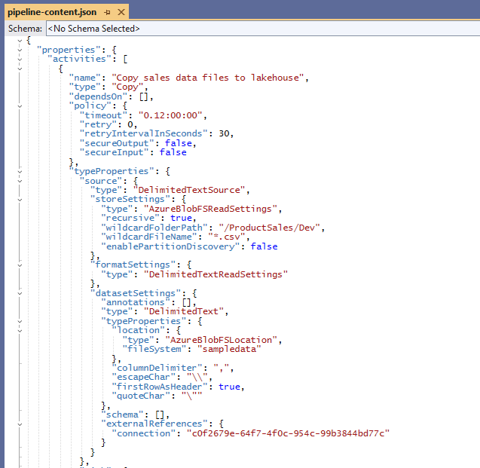
Datasource Paths and Connection Id in a Data Pipeline

Slide 41
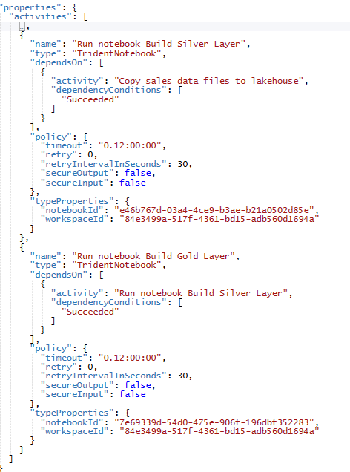
Workspace Id and Notebook Ids in Data Pipeline

Slide 42
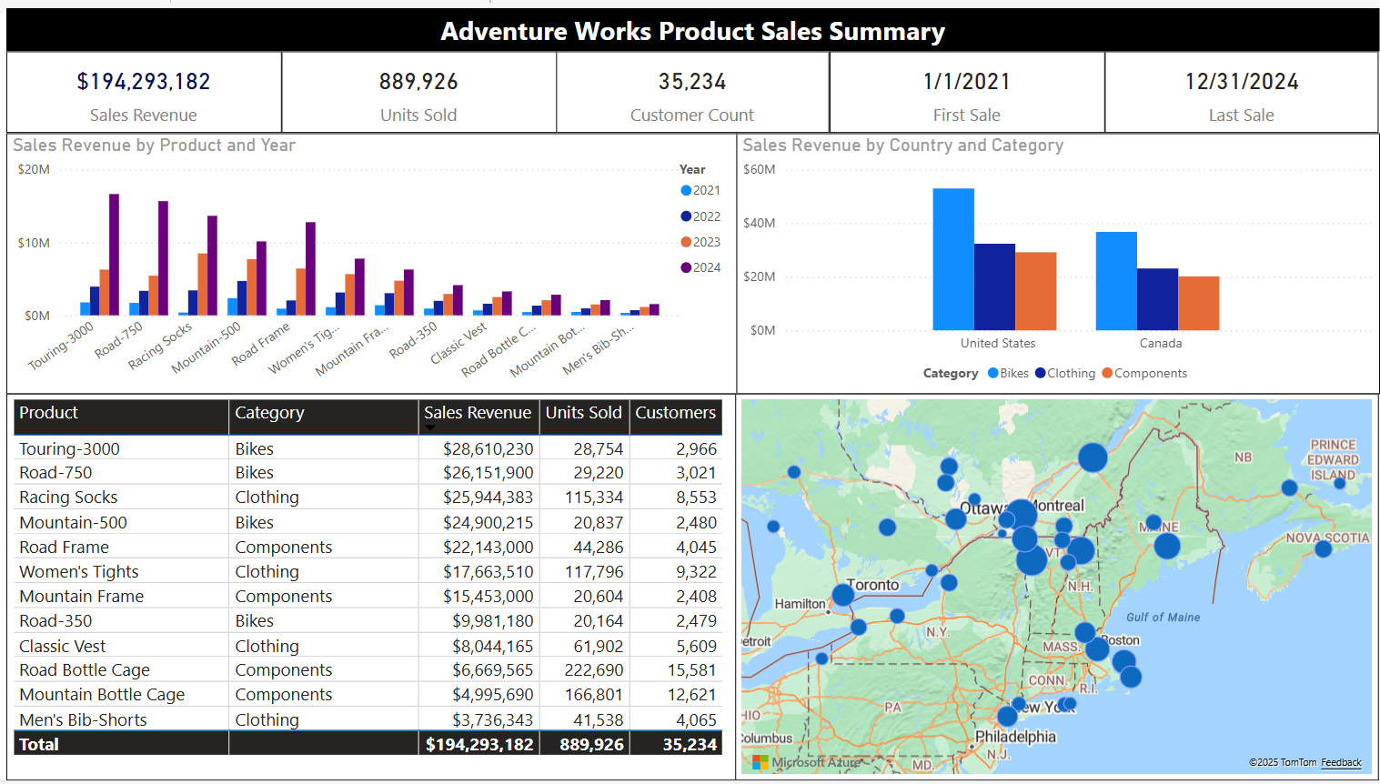
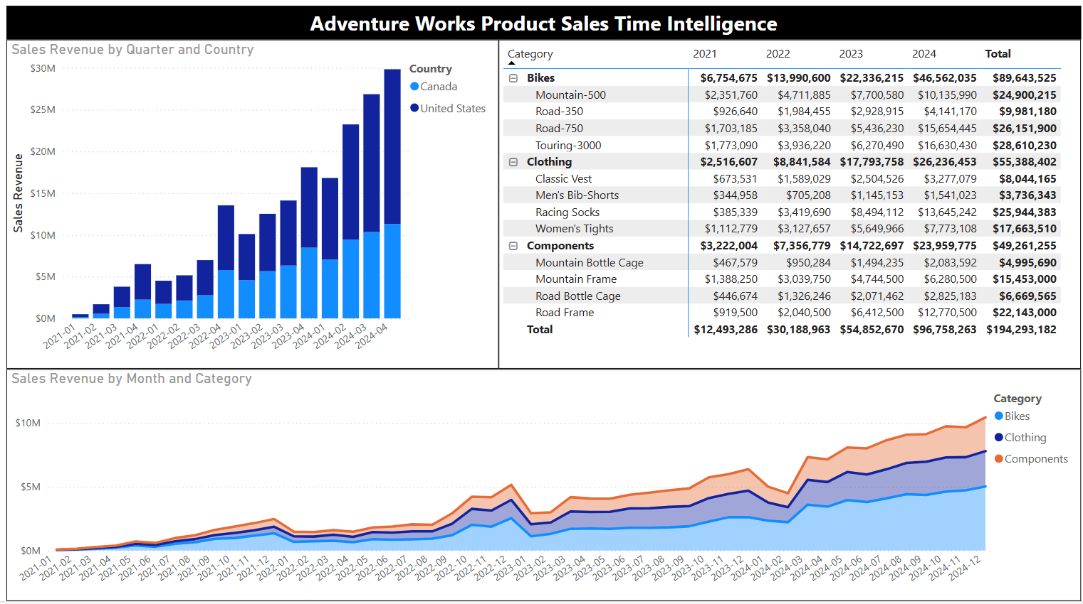
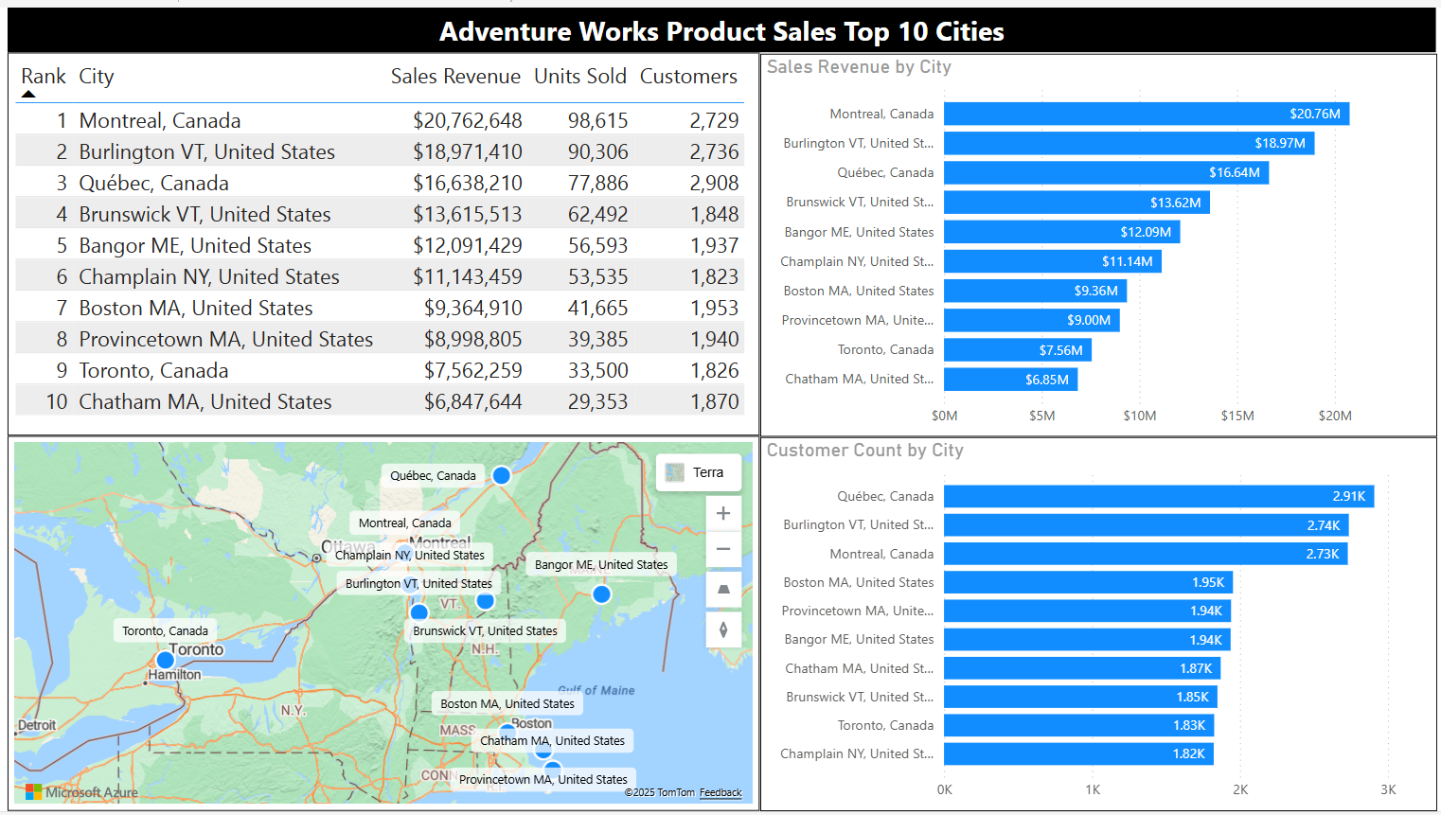
Adventure Works Sample Data

Slide 43
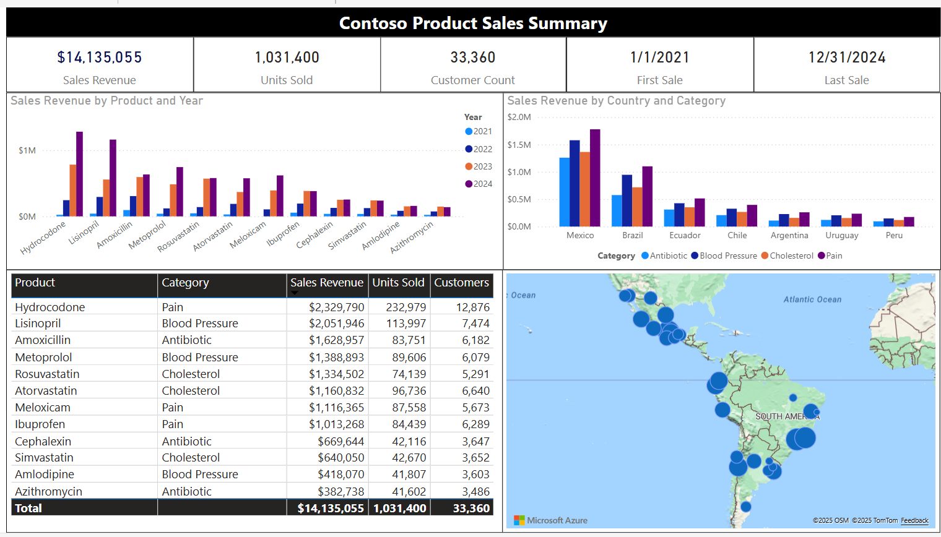
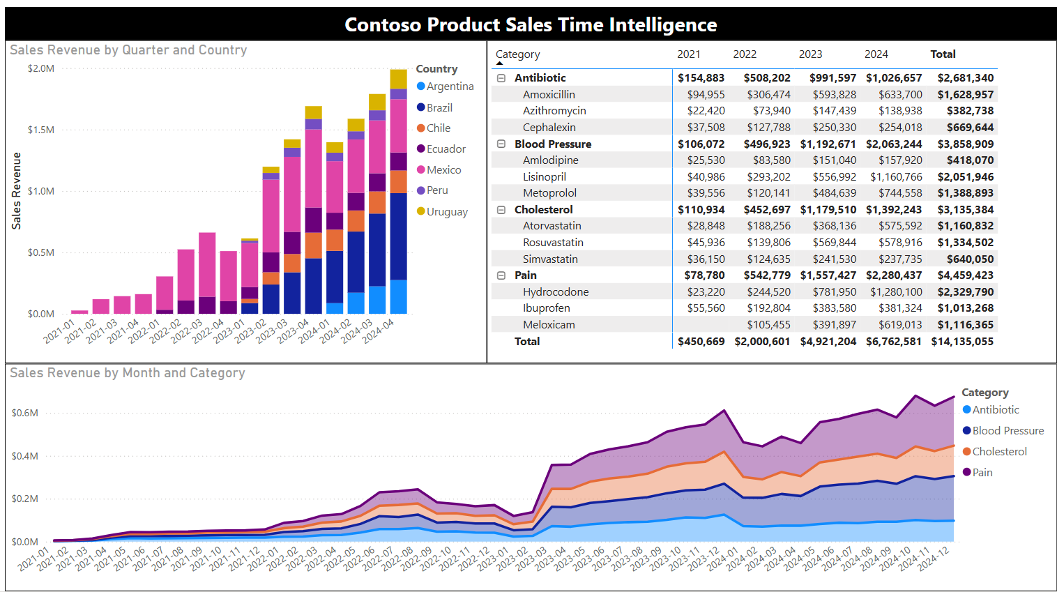
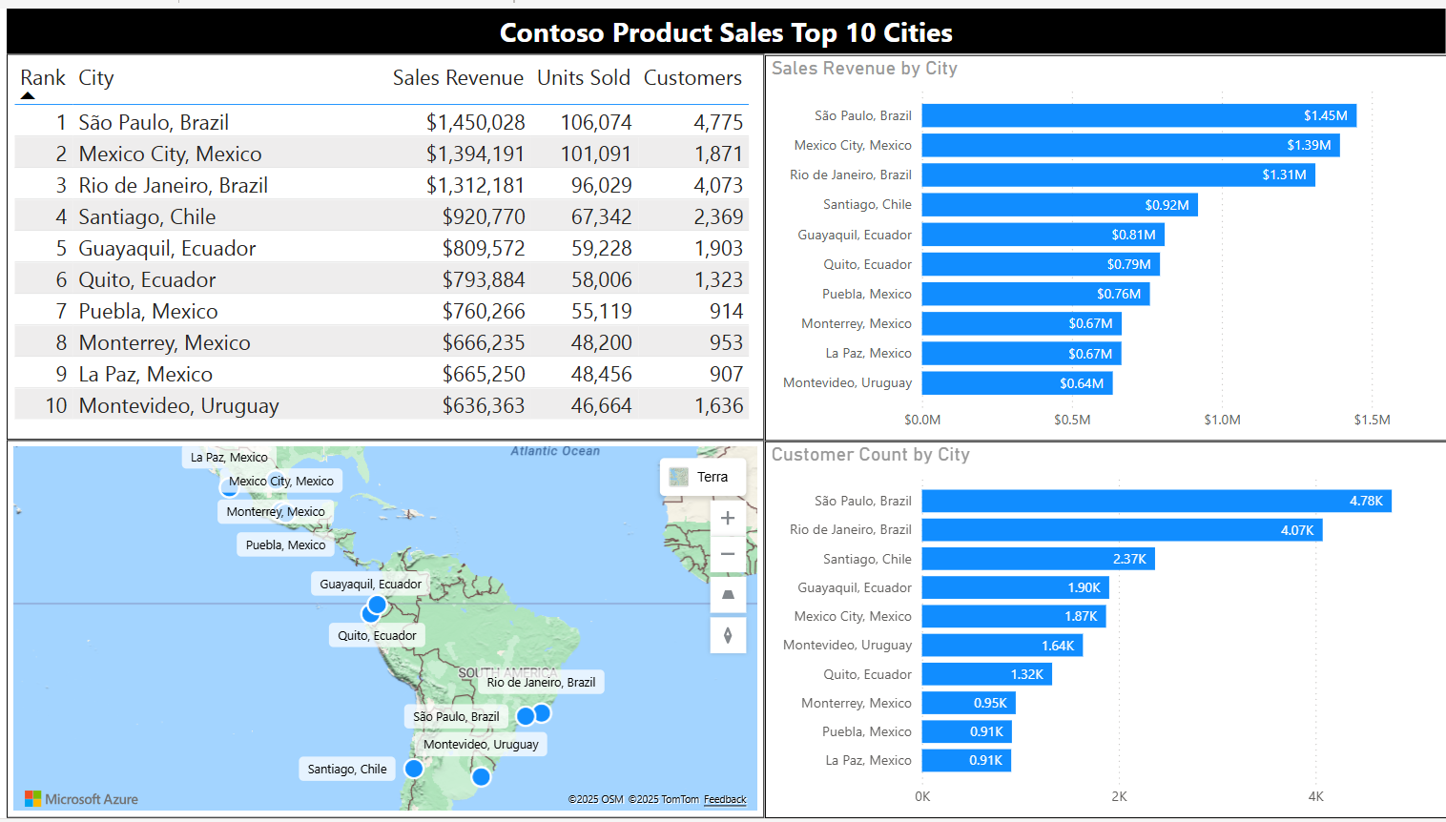
Contoso Sample Data

Slide 44
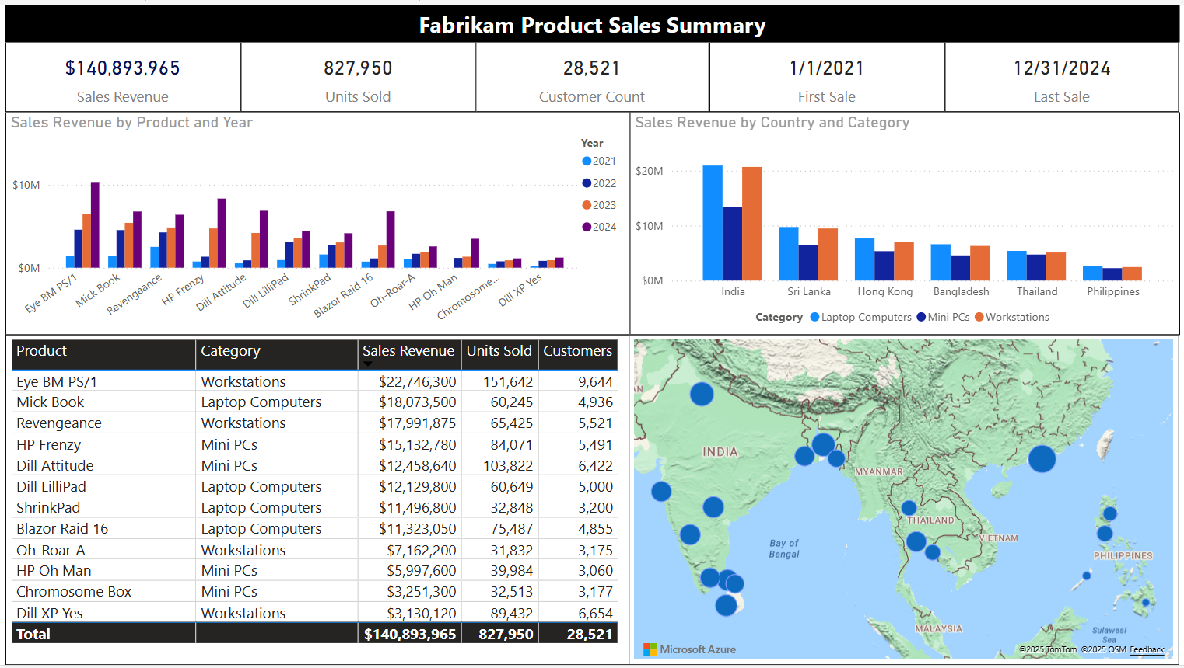
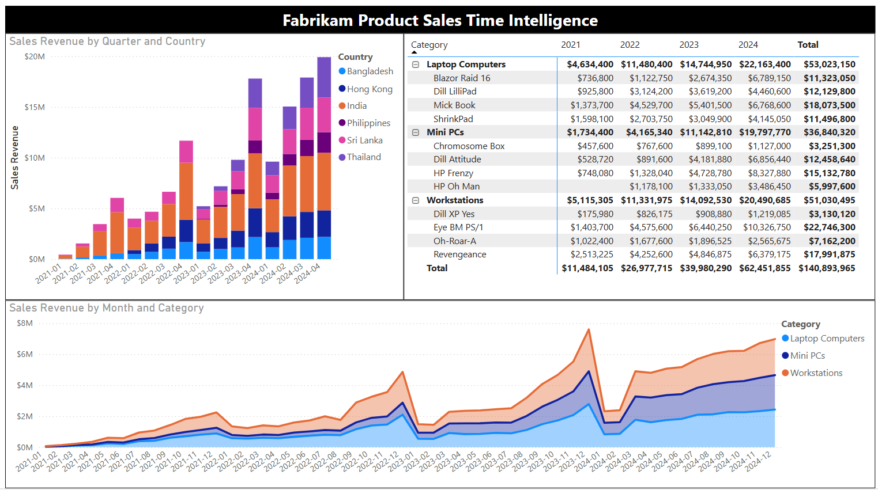

Fabrikam Sample Data

Slide 45



Northwind Sample Data

Slide 46



Wingtip Toys Sample Data

Slide 47



Seamark Farms Sample Data

Slide 48
Agenda
Fabric Strategies for CI/CD and Automating Solution Deployment
Creating Workspace Items using the Fabric REST APIs
Challenges in Fabric CI/CD and Solution Deployment
Configuring Datasource Paths using Deployment Parameters
Deploying and Updating Solutions from a Source Workspace
Exporting and Deploying Solutions using Solution Folders
Connecting Workspaces using Fabric GIT Integration
Setting Up Staged Deployments

Slide 49

Deploy Solution from Source Workspace
Solution deployed from source workspace designed as solution template
Developer calls Get Item Definition on source workspace items
Developer modifies item definitions from source to redirect dependencies
Developer calls Create Item to create new item in solution workspace
Deploy Solution Logic

Slide 50

Track Workspace Item Dependencies
Example of DeployFromSourceWorkspace function
Function creates large set of Dictionary<string, string> to track dependency substitutions
Function calls RecreateWorkspaceConnections

Slide 51


Recreating Source Workspace Connections
RecreateWorkspaceConnections calls GetWorkspaceConnections on source workspace
Conditional logic to create Web and AzureDataLakeStorage connections

Slide 52

Recreating Web Connections

Slide 53

Recreating ADLS Connections

Slide 54
Agenda
Fabric Strategies for CI/CD and Automating Solution Deployment
Creating Workspace Items using the Fabric REST APIs
Challenges in Fabric CI/CD and Solution Deployment
Configuring Datasource Paths using Deployment Parameters
Deploying and Updating Solutions from a Source Workspace
Exporting and Deploying Solutions using Solution Folders
Connecting Workspaces using Fabric GIT Integration
Setting Up Staged Deployments

Slide 55
Exporting for Fabric Solution Deployment
Export workspace to local solution folder and then deploy from local solution folder
Source Workspace
Packaged Solution Folder
Solution
Export
Logic
Solution Deployment Logic
Target
Workspace

Slide 56
Agenda
Fabric Strategies for CI/CD and Automating Solution Deployment
Creating Workspace Items using the Fabric REST APIs
Challenges in Fabric CI/CD and Solution Deployment
Configuring Datasource Paths using Deployment Parameters
Deploying and Updating Solutions from a Source Workspace
Exporting and Deploying Solutions using Solution Folders
Connecting Workspaces using Fabric GIT Integration
Setting Up Staged Deployments

Slide 57

Connecting Fabric Workspace to GIT Repositories
Fabric workspace can be connected to GIT repository
Fabric currently supports GIT repositories in Azure Dev Ops and GitHub
Workspace connections can be configured by hand or through Fabric REST APIs
Once connected, workspace items serialized as item definition files in GIT repository
GIT connection to workspace provides 2-way synchronization
Changes made to workspace items can be synchronized to GIT repository files
Changes committed to GIT repository files can be synchronized to workspace items
GIT
Sync

Slide 58


Workspace settings for Git Integration
Workspace can be connected to Azure Dev Ops repository from Workspace Settings
First, you need to create an Azure Dev Ops project and initialize its main repository
Create workspace connection to ADO repository using Git Integration tab in Workspace Settings dialog
Once connected, workspace items list shows Git status

Slide 59

Item Definitions maintained inside Git-enabled Repository

Slide 60
Fabric GIT APIs
Fabric GIT APIs allow developer to automate creating workspace connections
Connect | Connect a specific workspace to a git repository and branch.
Disconnect | Disconnect a specific workspace from the Git repository and branch it is connected to.
Initialize Connection | Initialize a connection for a workspace that is connected to Git.
Get Connection | Returns git connection details for the specified workspace.
Commit To Git | Commits the changes made in the workspace to the connected remote branch.
Get Status | Returns the Git status of items in the workspace, that can be committed to Git.
Update From Git | Updates the workspace with commits pushed to the connected branch. ConflictResolutionPolicy helps to determine which way to sync: GIT->Workspace or Workspace->GIT
60
Microsoft Fabric
Notes:
Talk about selective commit , changes as part of roadmap
Mention irreversible nature of workspace update from GIT

Slide 61

Feature Workspaces
Continuing development performed using branches and feature workspaces
Dev Workspace
GIT Integrated Serialization
feature01 Branch
main Branch
feature03 Branch
Feature01 Workspace
Feature03 Workspace
pull requests
pull requests
feature02 Branch
feature04 Branch
Feature02 Workspace
Feature04 Workspace
pull requests
pull requests

Slide 62
Agenda
Fabric Strategies for CI/CD and Automating Solution Deployment
Creating Workspace Items using the Fabric REST APIs
Challenges in Fabric CI/CD and Solution Deployment
Configuring Datasource Paths using Deployment Parameters
Deploying and Updating Solutions from a Source Workspace
Exporting and Deploying Solutions using Solution Folders
Connecting Workspaces using Fabric GIT Integration
Setting Up Staged Deployments

Slide 63
Staged Deployment for Enterprise Scenario
High-level architecture for CI/CD on a single target workspace
Changes are propagated to DEV workspace using feature workspaces and pull requests
Changes pushed from DEV to TEST to PROD during testing and approval process
Create customer tenants by running DEPLOY workflow from PROD
Update customer tenants by running UPDATE workflow from PROD
Dev Workspace
Test Workspace
Prod Workspace
feature01 Branch
GIT Integrated Serialization
Custom Serialization
Logic
Custom Deserialization
Logic
Custom Deserialization
Logic
Feature01 Workspace
Custom Serialization
Logic
main Branch
pull requests
feature01 Branch
Feature01 Workspace
pull requests

Slide 64
Parameterizing Datasources in Staged Deployment
Each stage in staged deployment should connect to its own needs datasource paths
DEV and TEST stage workspaces should not connect to same datasources as PROD
dev stage
test stage
production stage
Dev Workspace
Test Workspace
Prod Workspace
Deploy
or
Update
Deploy
or
Update
Dev DB
Test DB
Production DB

Slide 65

Dev Environment Data

Slide 66

Test Environment Data

Slide 67

Prod Environment Data

Slide 68
Staged Deployment for Multitenant Scenario
High-level architecture for CI/CD with multiple target workspaces
Changes are propagated to DEV workspace using feature workspaces and pull requests
Changes pushed from DEV to TEST to PROD during testing and approval process
Create customer tenants by running DEPLOY workflow from PROD
Update customer tenants by running UPDATE workflow from PROD
Dev Workspace
Test Workspace
Prod Workspace
Customer 1 Workspace
feature01 Branch
GIT Integrated Serialization
Custom
Export
Logic
Custom
Import
Logic
Custom
Export
Logic
Custom Deserialization
Logic
Feature01 Workspace
Deploy
or
Update
main Branch
pull requests
Customer 2 Workspace
Deploy
or
Update
feature01 Branch
Feature01 Workspace
pull requests
Deploy
or
Update
Customer N Workspace

Slide 69
Summary
Fabric Strategies for CI/CD and Automating Solution Deployment
Creating Workspace Items using the Fabric REST APIs
Challenges in Fabric CI/CD and Solution Deployment
Configuring Datasource Paths using Deployment Parameters
Deploying and Updating Solutions from a Source Workspace
Exporting and Deploying Solutions using Solution Folders
Connecting Workspaces using Fabric GIT Integration
Setting Up Staged Deployments

Slide 70
Staged Deployment for Multitenant Scenario
This is the architecture used by the open-source project fabric-cicd
More info: https://microsoft.github.io/fabric-cicd/latest/
Features Workspace
Dev Workspace
Test Workspace
Prod Workspace
feature01 Branch
GIT Integrated Serialization
Custom
Import
Logic
Custom
Import
Logic
Custom
Import
Logic
Feature01 Workspace
Lowest Branch
pull requests
PR from Lowest Brnach
Pull Request
Pull Request
feature01 Branch
Feature01 Workspace
pull requests

Slide 71



Imported Semantic Model and Reports
This is the classic Power BI provision flow
Create semantic model by calling CreateItem with item definition
Patch datasource credentials for semantic model (Power BI REST API)
Refresh semantic model (Power BI REST API)
Create report(s) by calling CreateItem with item definition which contains semantic model Id
Custom ISV Application
Customer Tenant Workspace
Semantic Model
report
Create Semantic Model
Patch Datasource Credentials
report
Refresh Semantic Model
Create Report
Imported Data
External Data Files

Slide 72


Create Lakehouse, Notebook and DirectLake Model
Custom ISV Application
Customer Tenant Workspace
Lakehouse - Sales
Semantic Model
Gold layer
report
Run Python Notebook
SQL Endpoint
report
Lakehouse - Staging
Silver layer
Run Python Notebook
bronze layer
Run Python Notebook
External Data Files

Slide 73
Create Warehouse using Data Pipelines
Custom ISV Application
Customer Tenant Workspace
Create Warehouse
Warehouse - Sales
Semantic Model
Gold layer
report
Create/Run Data Pipelines
Create tables
Create stored procedures
Refresh all tables
SQL Endpoint
report
Lakehouse - Staging
Silver layer
Create Lakehouse
Create/Run Data Pipeline
load lakehouse tables
External Data Files

Slide 74


Create Tenant with Shortcut and LoadTable API
Custom ISV Application
Customer Tenant Workspace
Warehouse - Sales
Semantic Model
Gold layer
report
Create & Run the same
Data Pipelines as Demo04
SQL Endpoint
report
Lakehouse - Staging
Silver layer
Fabric LoadTable API
bronze layer
Create Shortcut API

Slide 75

Create Tenant with Warehouse and SqlClient
Custom ISV Application
Customer Tenant Workspace
Warehouse - Sales
Semantic Model
Gold layer
report
Execute SQL using SqlClient
Create tables
Create stored procedures
Refresh all tables
SQL Endpoint
report
Lakehouse - Staging
Silver layer
Fabric LoadTable API
bronze layer
Create Shortcut API

Slide 76

Create Tenant with ADLS Gen2 API
Custom ISV Application
Customer Tenant Workspace
Warehouse - Sales
Semantic Model
Gold layer
report
SQL Commands
SQL Endpoint
report
Lakehouse - Staging
Silver layer
Tables –Load Table
bronze layer
ALDLS Gen2 API

